Slide 1
IB English Language and Literature
6 ELL SL 4
2019 - 2020
Shape of the Week (1):
Lesson 1: Prelim Prep – Commentary Writing
Lesson 2: Prelim Prep – Commentary Writing

Slide 2


SCHOOL ASSESSMENT TERM 3
☑ PRELIMS!!!

Slide 3
General Outline Term 3
WEEK 1 Paper 2 Prelim Prep
WEEK 2 Paper 1 Prelim Prep
WEEK 3 Prelims
WEEK 4 Prelims
WEEK 5 WT finalisation
WEEK 6 Chronicle
WEEK 7 Chronicle
WEEK 8 Chronicle
WEEK 9 Chronicle

Slide 4



We are still a digital classroom!

Slide 5

Homework
Try your hand at the introduction given paper 1 2013.

Slide 6
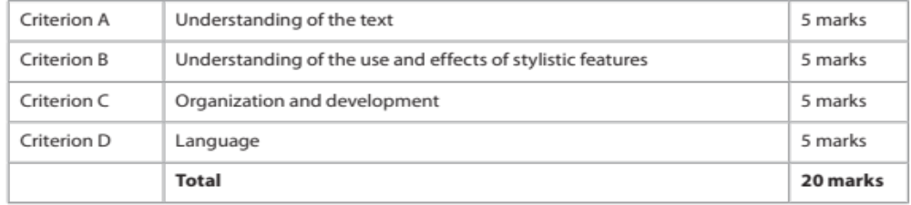
What you might see on Paper 1:
Two different non- literary texts to be read, for instance:
  advertisement
  opinion column
  extract from an essay
  electronic text (such as social networking sites, blogs)
  brochure (such as a public information leaflet)
  extract from a memoir, diary or other autobiographical text.
Two guiding questions at the end of each – choose ONE to analyse as written commentary in about 70 minutes.

Slide 7
Go to Firefly
Open Paper 1 Template

Slide 8
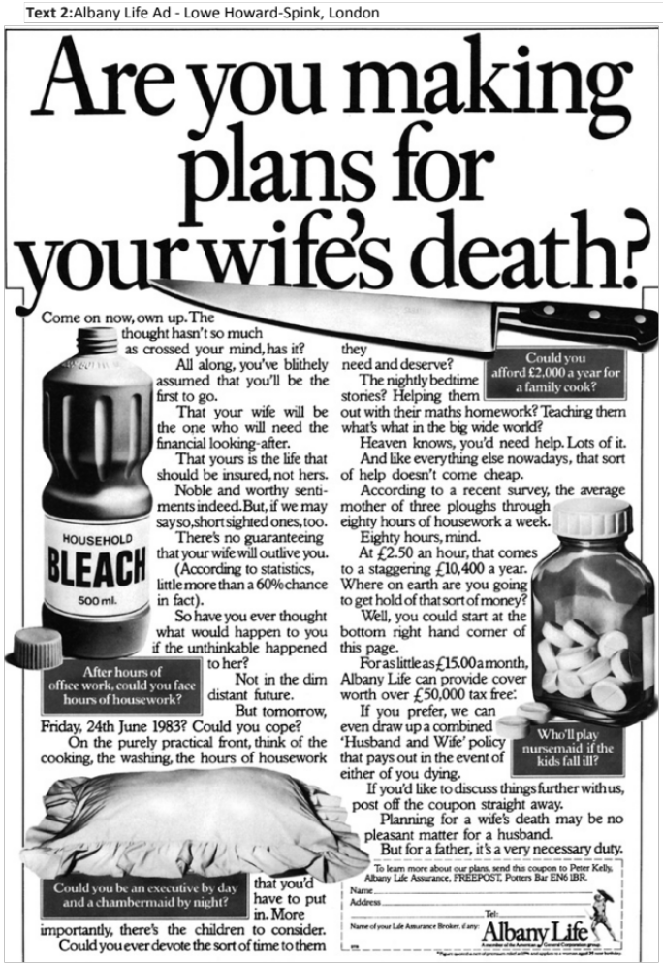
Use Handout 1 to analyse this Paper 1 text for The Big Five.

Slide 9
Model Intro
Lead-in
This British magazine advertisement for Albany Life insurance, created by Lowe Howard-Spink around the early 1980s uses a contrast between form and content to playfully approach a serious topic, producing a humourous yet memorable effect on the reader.
Thesis Statement
Targeting middle-aged and older married men, it aims to convince husbands to purchase life insurance for their wives. The ad’s theme of looking to the future and the event of unhappy possibilities is juxtaposed with its novel method of engaging responders with a light-hearted tone, rather than frightening them with dark predictions.
Essay Map
The mechanism of persuasion lies in the form and structure of the text, as well as the diction to maintain an authoritative, yet lively voice appropriate yet unconventional for content and context.

Slide 10

The Big 5 – Revision
There are several questions that you can ask of any text. Here are five major questions that apply to almost all types of texts:
Audience / purpose - Whom does the text target? What does the author wish to achieve through the text?
Content / theme - What is literally ‘happening’ in the text? What is it about? What are the main ideas of the text?
Tone / mood - How does the text make you and/or the target audience feel? Describe the atmosphere of the text.
Stylistic devices - How does the author use language to convey a sentiment or message? What kinds of linguistic tools does he/she employ?
Structure - How is the text organized, literally (i.e. layout/formatting)? What kinds of structural elements of a particular text type do you see?

Slide 11
Body paragraphs
Audience and Purpose Paragraph (PEEL)
Content and Theme Paragraph (PEEL)
Tone and Mood Paragraph (PEEL)
Technique Paragraphs (PETEL)
Follow the simple P.E.T.E.L. structure
P: State your topic sentence (what your paragraph will be about – a Point which supports Thesis Statement)
E: Refer to specific Example in the text
T: Identify a Technique used in the Example to create meaning about the Point. (Device or Structure)
E: Explain how this example supports the key concept you are discussing and
L: Link its effectiveness for the overall text.
(Use your Close Reading Template [Handout 4] to help guide you on what details to include)

Slide 12


Communication – Response Model
Language used
to create
meaning
Medium (text type)
Genre
Social Purpose
Theme
Ideas and values promoted
Style
Structure
Communication Process
Composer or producer of the text.
Context 1 - the immediate social, cultural and historical circumstances of the composition.
Responder or interpreter of text.
Context 2: the immediate social, cultural and historical circumstance of reception.
Meanings

Slide 13
PETEL Paragraphs
Now all of you may add more than one technique per PETEL paragraph!
Point – statement about communicating idea to responders.
Examples – of a particular technique the composer has used to communicate that idea. Techniques – discussion of the way in which the technique effectively communicates this. These should be addressed together, maybe in the same sentence.
Explanation – of the effect of technique on the responders.
Link – connects this point to the thesis statement overall.

Slide 14
Go to Firefly
Open Past Paper 2013

Slide 15
Model Intro
Lead-in
Thesis Statement
Essay Map

Slide 16
What does your essay map look like? What are your 3 points for the PETEL paragraphs?
Write ONE PETEL paragraph to send through Firefly.
Point1
Richards effectively utilises the first person and the second person pronouns in this excerpt to directly 'speak' with the readers thereby establishing a beautiful conversational tone in the text.
Point 2
Next, Richards utilises diction, figurative language and tricolon to inform the readers about the pathbreaking invention of music recording and the birth of the blues and jazz, and what it meant for the ordinary people in terms of accessibility to music.
Point 3
Moreover, Richards effectively uses the handwritten note to establish his stance on music that people should not rely on traditional musical conventions to learn music and that they can learn music through listening.

Slide 17
Homework
^{Good Luck on Prelims!}

